Slide 1
Wordle Coach
Team Odin

Slide 2
Meet the Team
Customer – Jamie Kirk
End users – anyone who wishes to get better at playing Wordle
Team Lead / Facilitator – Zan Wills
UX/UI Developers - Zan Wills, Dennis Mayher
Algorithm Developer - Jamie Kirk
Testers / Documenters - Nathan Hoernlein, Parth Patel
Notes:
Jamie

Slide 3
Requirements
The Wordle Coach app shall:
Allow the user to enter a 5-letter guess (6 times)
Allow the user to undo a guess
Allow the user to start over (reset their guesses)
Allow the user to open up a help screen
Read from a word list file to display the next best guesses for the user
Show the top 25 next likely words based on previous guesses and their probability of being correct
Notes:
Dennis

Slide 4
Software Development Methodology & Schedule
Iterative Waterfall Model
We chose this model because our application was fairly easy to develop and our requirements were straightforward and consistent throughout the development process
Schedule (10 weeks)
Weeks 1-2 (Sept. 25 - Oct. 8) - worked on the prototype algorithm (Python) and created repository
Weeks 3-4 (Oct. 9 - Oct. 22) - began UI implementation in Java
Weeks 5-6 (Oct. 23 - Nov. 5) - started searching for bugs and finalized UI design
Weeks 7-8 (Nov. 6 - Nov. 19) - began migration of algorithm code from Python to Java
Weeks 9-10 (Nov. 20 - Dec. 3) - tested our code and prepared for the demo
We also dedicated time in each set of 2 weeks to work on our documentation
Notes:
Zan

Slide 5
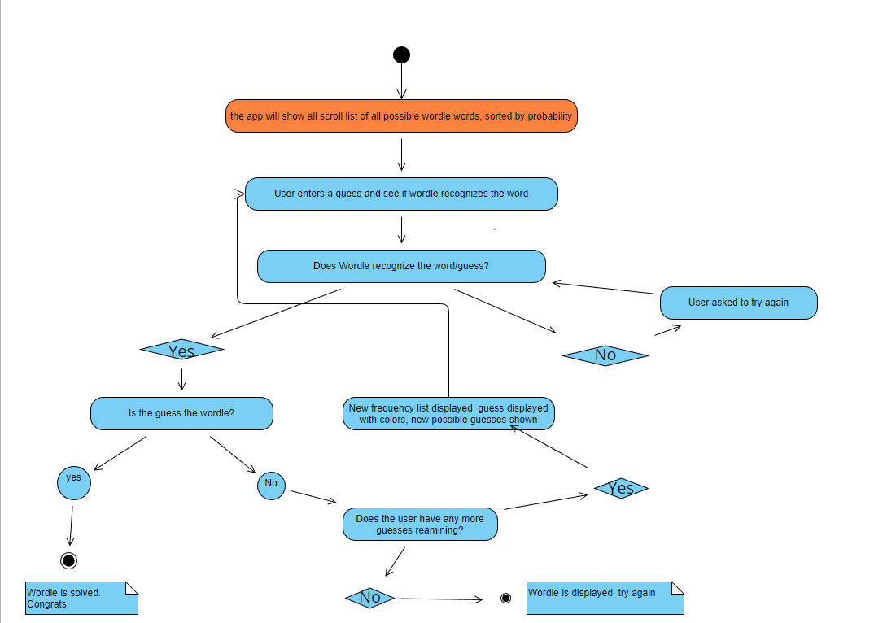
Activity Diagram
Notes:
Parth

Slide 6
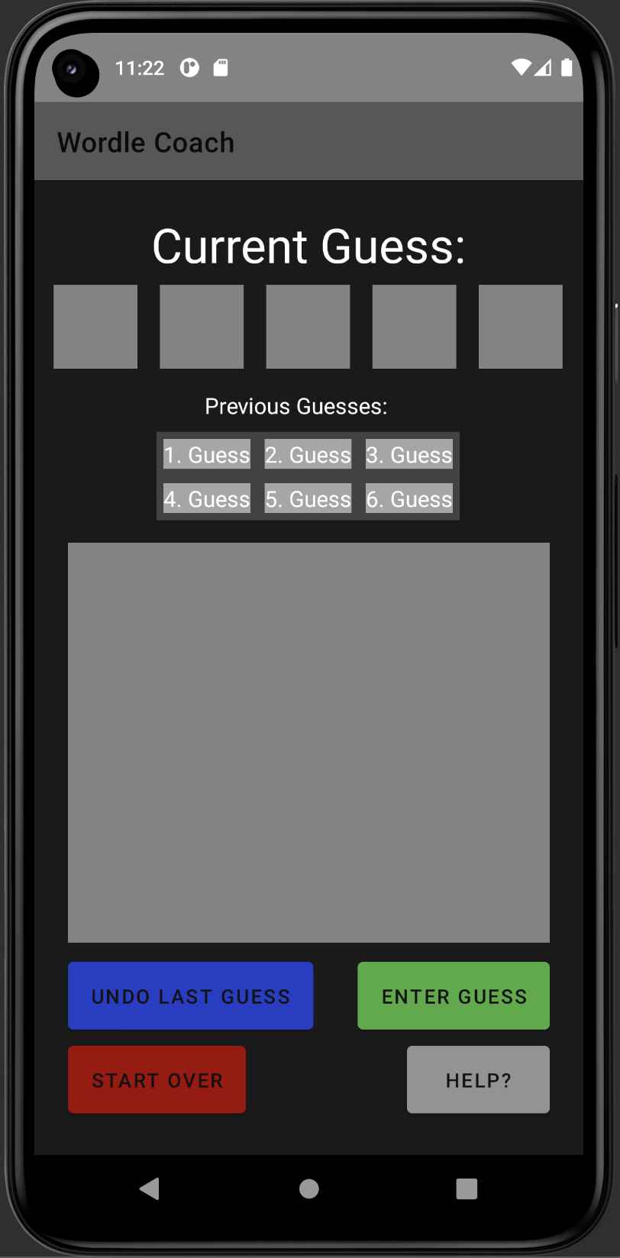
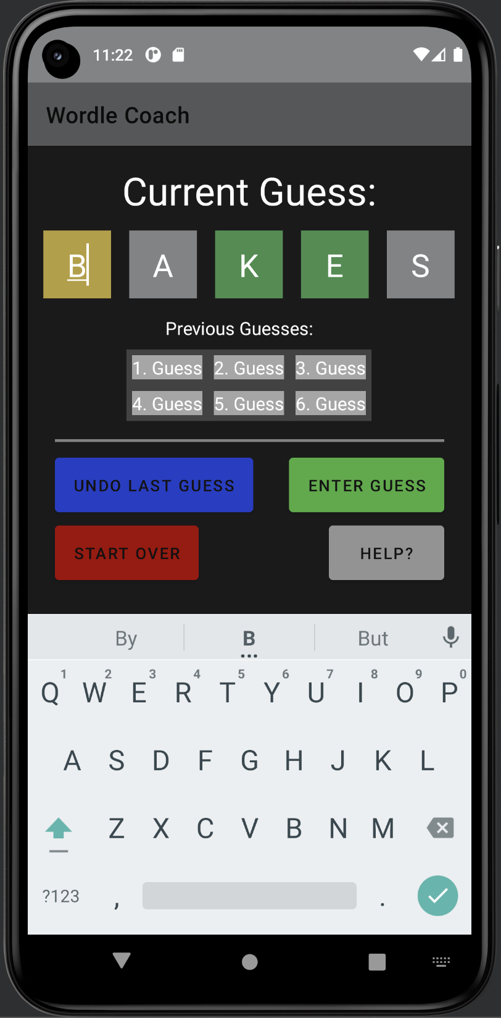
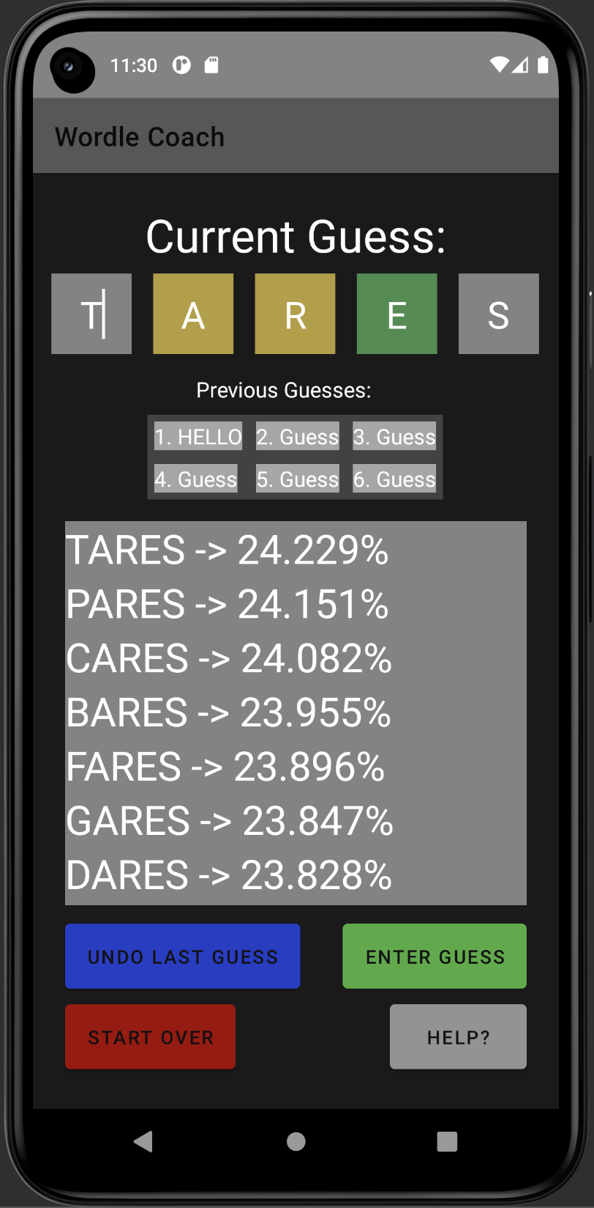
UI Diagrams
Notes:
Nathan

Slide 7
External Interfaces
We do not have any external interfaces for our project.
All of our UI components are in the app itself (no PII, database, API calls, etc.).
Notes:
Dennis

Slide 8
Configuration Management
We used a GitHub repository to store all the source code for our files, including the Wordle acceptable word list, our algorithm prototype (Python), and the UI implementation with the algorithm (Java/Kotlin).
We also kept version control of our documents in case we needed to make any updates or changes.
Notes:
Nathan

Slide 9
Security
Our developers used secure coding practices
Input validation on guesses (for example, checking that a valid word was entered) and color selection (for example, impossible to select 4 green letters and a yellow letter)
Error screens pop up when the user enters bad data
Our code was kept in a private GitHub repository, so that no one else could copy or take our code
Notes:
Parth

Slide 10
Demo
Notes:
Jamie

